Slide 1
Unlock the Unanswered Secrets of the Product Name Dropped the Of
Scraping, Processing, Analysis and Automatic Generation of Amazon.com Product Reviews
-Markov-Chain title generated from project 4 and project 5 papers
John Feilmeier
dataset of the blades are relly sharp be careful and down

Slide 2
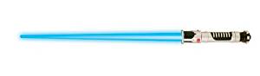
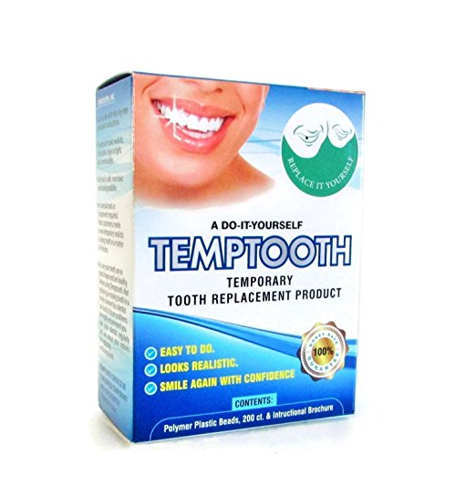
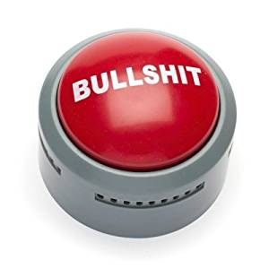

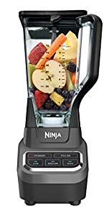
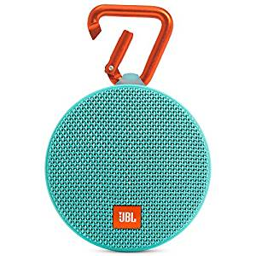
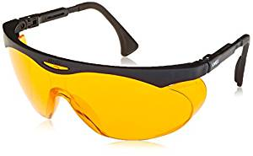
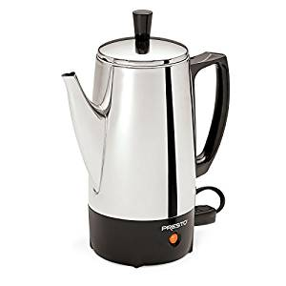
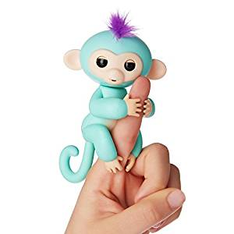
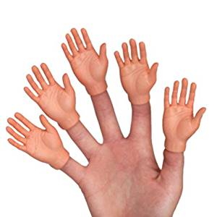
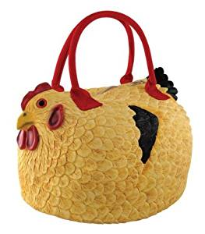
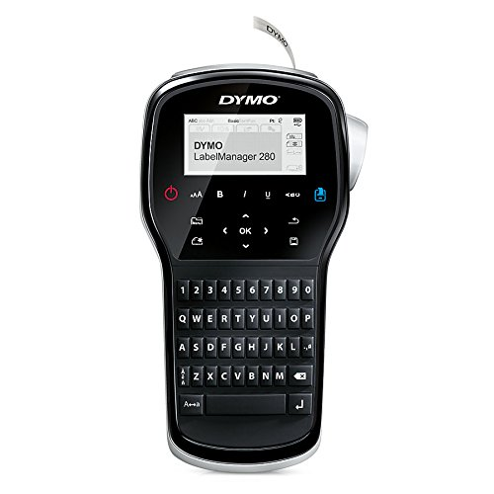

Slide 3
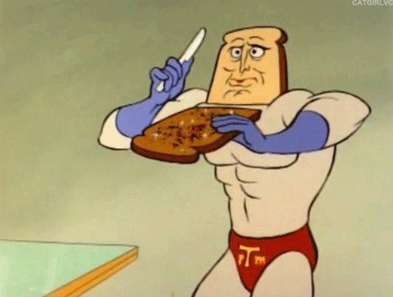
DATA SCRAPING

Slide 4
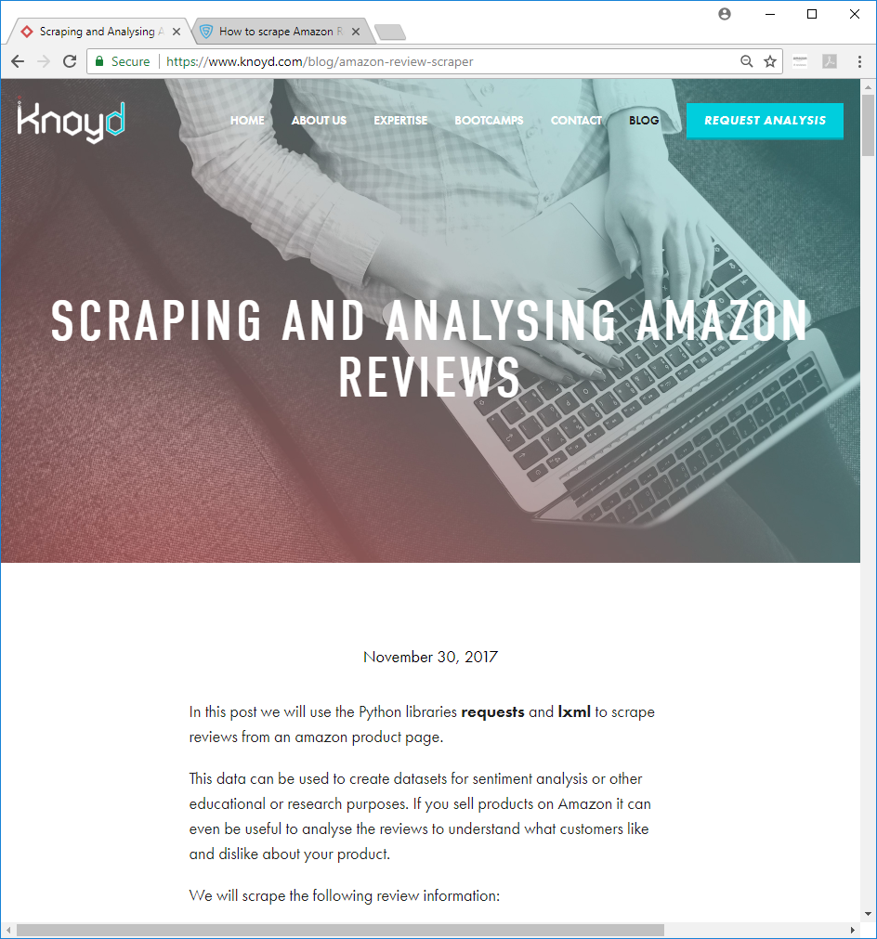
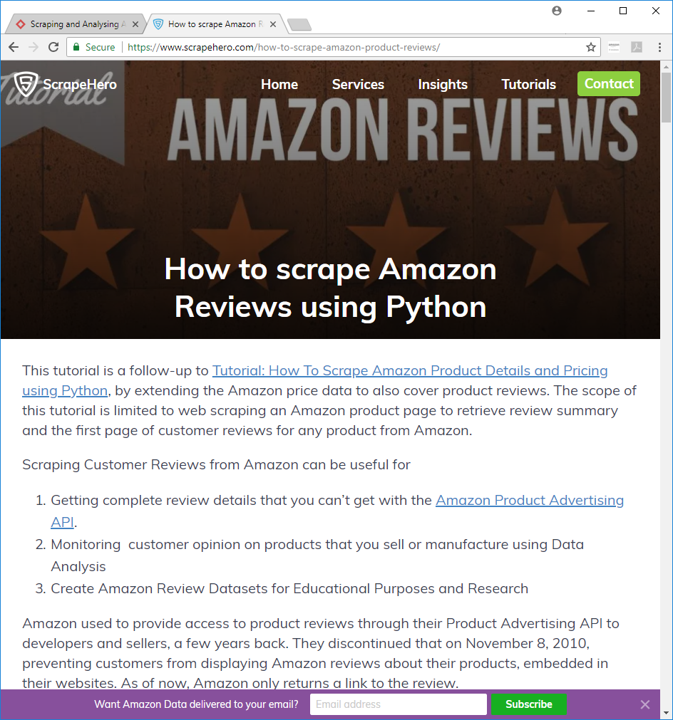

Slide 5
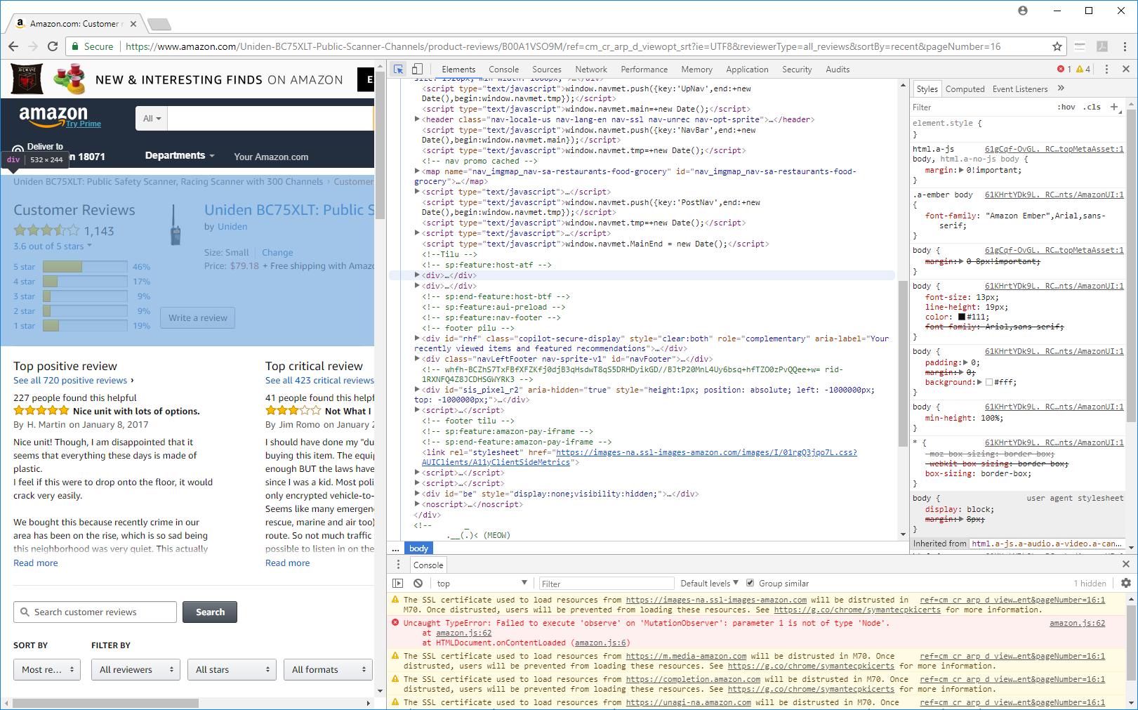

Slide 6
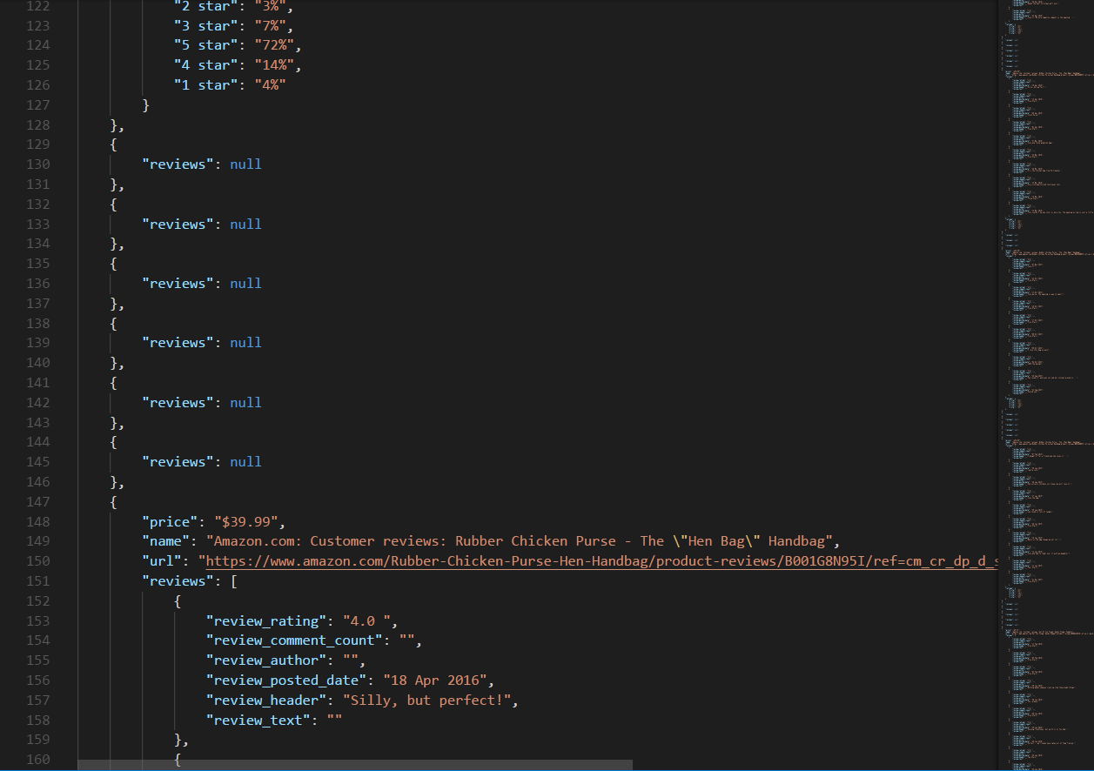

Slide 7
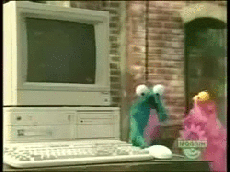
DATA PREPROCESSING

Slide 8
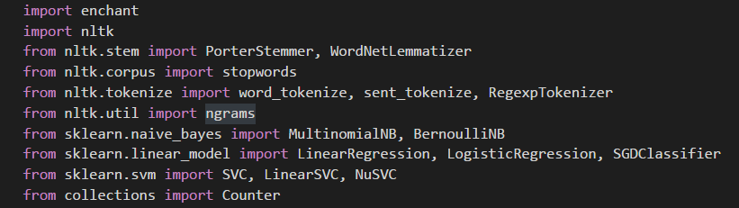
NLTK - Natural Language Tool Kit

Slide 9
(('of', 'the'), 1402), (('i', 'have'), 1232), (('in', 'the'), 1137), (('it', 'is'), 1073), (('on', 'the'), 932), (('this', 'is'), 868), (('and', 'i'), 796), (('it', None), 778), (('for', 'a'), 755), (('is', 'a'), 752), (('it', 'was'), 744), (('i', 'was'), 740), (('and', 'it'), 738), (('for', 'the'), 731), (('and', 'the'), 715), (('to', 'use'), 683), (('i', 'am'), 664), (('easy', 'to'), 650), (('to', 'be'), 641), (('for', 'my'), 626), (('if', 'you'), 615), (('this', 'product'), 586), (('but', 'i'), 570), (('to', 'the'), 523), (('with', 'the'), 516), (('i', 'bought'), 499), (('i', 'love'), 496), (('my', 'hair'), 495), (('i', 'had'), 491), (('as', 'a'), 487)

Slide 10
(('it', None, None), 778), (('a', 'lot', 'of'), 265), (('this', 'is', 'a'), 262), (('great', None, None), 254), (('easy', 'to', 'use'), 250), (('product', None, None), 237), (('love', 'it', None), 206), (('i', 'bought', 'this'), 206), (('i', 'had', 'to'), 161), (('out', 'of', 'the'), 159), (('for', 'the', 'price'), 158), (('price', None, None), 157), (('as', 'a', 'gift'), 154), (('use', None, None), 147), (('this', 'is', 'the'), 147), (('well', None, None), 146), (('i', 'have', 'to'), 134), (('i', 'love', 'it'), 132), (('i', 'love', 'this'), 131), (('again', None, None), 131), (('works', 'great', None), 125), (('good', None, None), 123), (('this', 'for', 'my'), 118), (('money', None, None), 117), (('it', 'is', 'a'), 117), (('it', 'was', 'a'), 114), (('one', 'of', 'the'), 114), (('i', 'have', 'a'), 113), (('this', 'as', 'a'), 111), (('if', 'you', 'are'), 109)

Slide 11
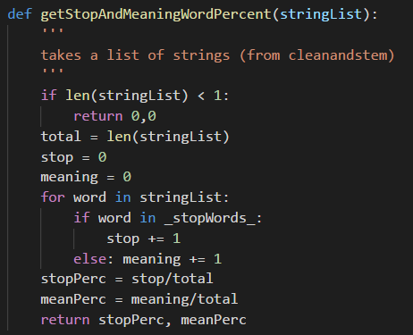
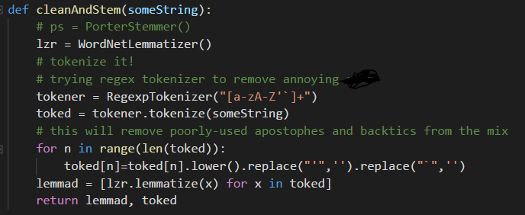

Slide 12
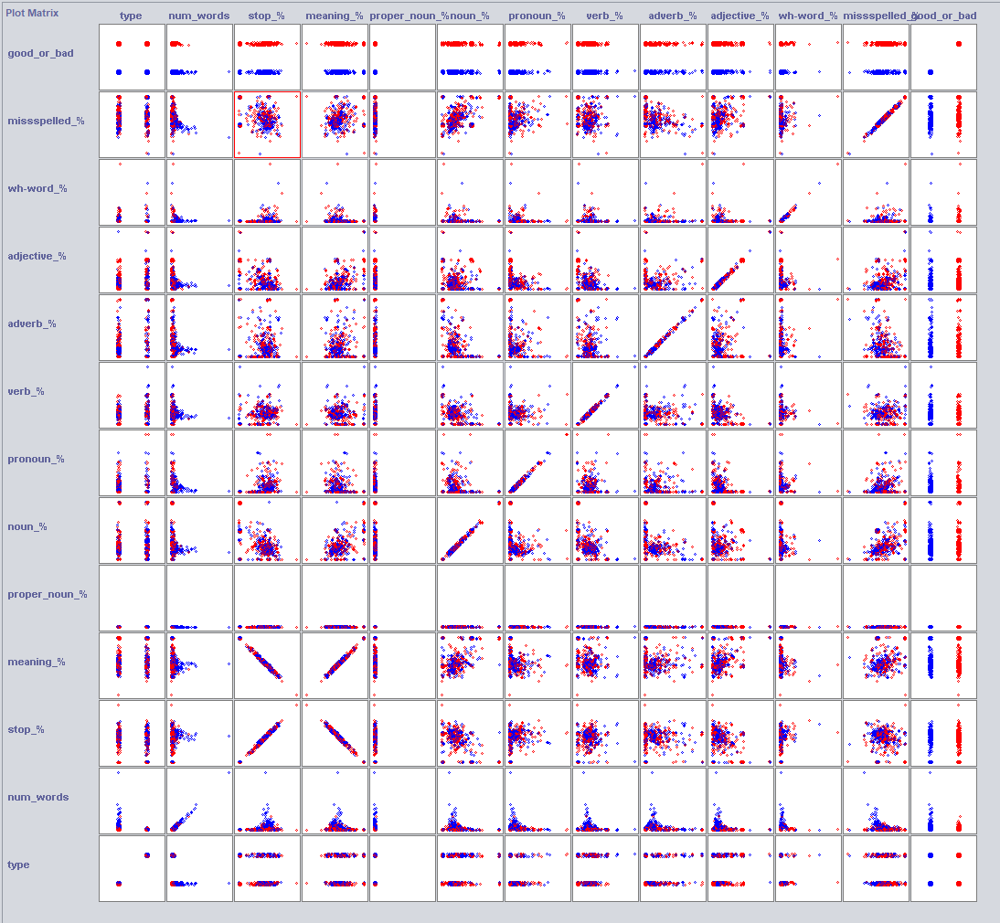
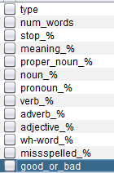

Slide 13
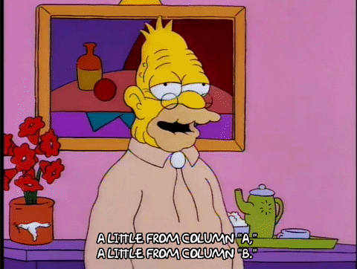
CLASSIFYING THE DATA

Slide 14
METHOD | % CORRECT ON FULL BIGRAM DATA | % CORRECT ON SELECTED ATTRIBUTES IN BIGRAM DATA | % CORRECT ON FULL ‘SMART’ DATA | % CORRECT ON SELECTED ATTRIBUTES IN ‘SMART’ DATA
NaiveBayes | 70.3933 % | 65.99 % | 59.9911 % | 60.0452 %
BayesNet | 70.3933 % | 66.2646 % | 62.3125 % | 60.7289 %
NaiveBayesMultinomial | 73.5314 % | 66.1665 % | 56.9026 % | 59.6911 %
Logistic | 72.7175 % | 66.3528 % | 62.7256 % | 61.2551 %
OneR | 54.3003 % | 54.3003 % | 59.1206 % | 59.1206 %
DecisionTable | 63.9011 % | 64.5092 % | 62.5486 % | 60.5075 %
RandomTree | 67.4512 % | 65.8037 % | 60.1682 % | 59.4206 %
J48 | 71.5505 % | 65.8527 % | 63.6158 % | 60.9649 %
MultilayerPerceptron | 60.1549 % | 64.2542 % | 63.3601 % | 61.7961 %

Slide 15
Useful Attributes selected by WEKA’s select algorithm
('i', 'love') ('love', 'this') ('in', 'the') ('at', 'all') ('did', 'not') ('does', 'not') ('love', 'it') ('would', 'not') ('the', 'box') ('great', None) ('do', 'not') ('the', 'product') ('the', 'first') ('for', 'my') ('great', 'product') ('will', 'not') ('to', 'return') ('easy', 'to') ('i', 'thought') ('works', 'great') ('of', 'the') ('the', 'same') ('not', 'work')

Slide 16
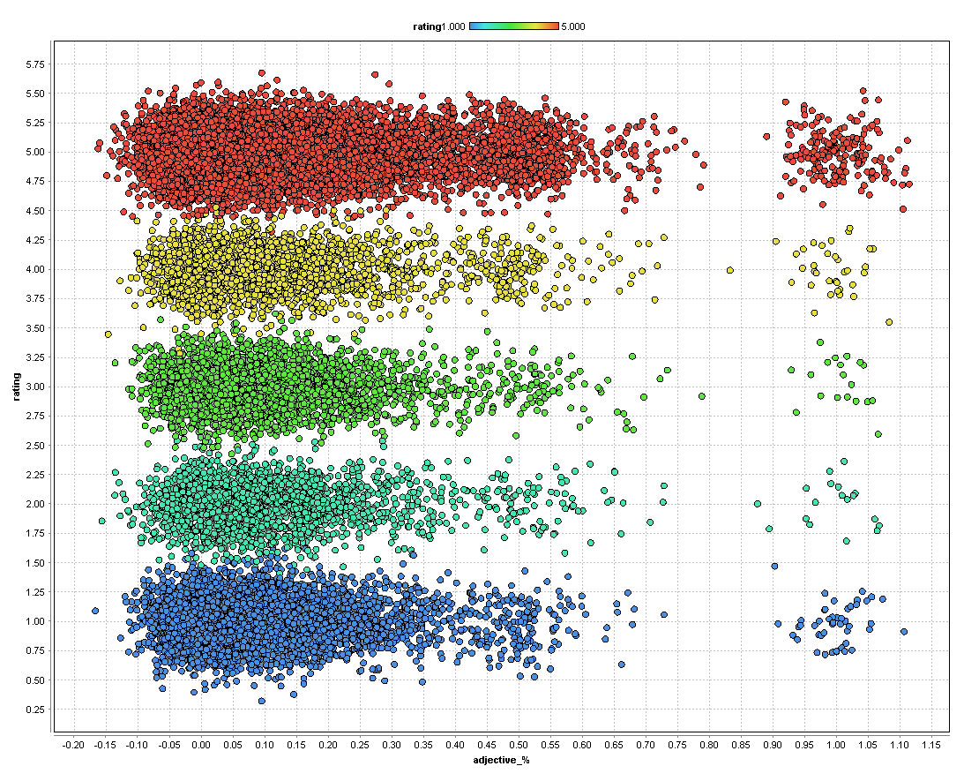
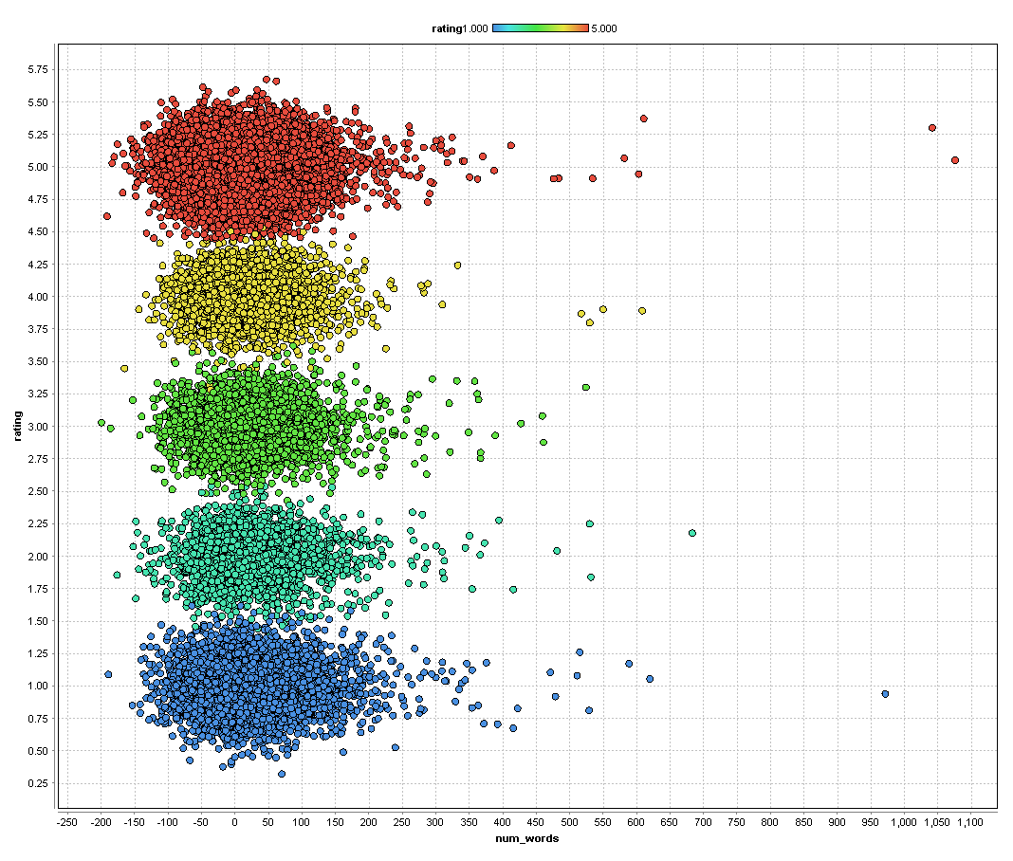
Useful Attributes selected by WEKA’s select algorithm
stop_%, pronoun_%, verb_%, adverb_%, adjective_%, wh-word_%, missspelled_%

Slide 17
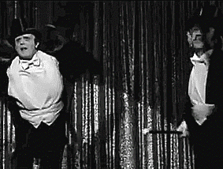
GENERATING NEW DATA

Slide 18
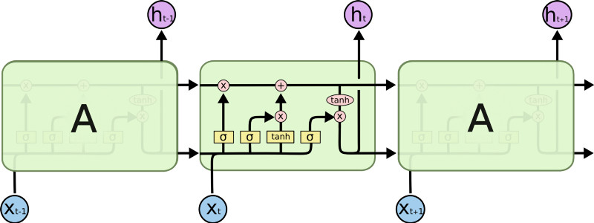
http://colah.github.io/posts/2015-08-Understanding-LSTMs/
"st book this is a good book but i would recommend having the first one as well if you own the crysta"ld it was a gift for my daughter for a good product i had to return it and the sound quality is a gigt for my daughter and the sound quality is a gigt for my daughter and the sound quality is a gigt for my daughter and the sound quality is a gigt for my daughter and the sound quality is a gigt for my daughter …(7 more lines of this) … and the sound qua

Slide 19
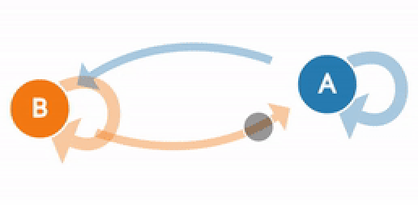
“aren't” so great product works great product you had latex allergies also vinyl is back i thought it was the wine opener sure makes opening a bottle with friends also easier on the counter cabinets unless you take it with my chicken purse i thought but over all clad but actually it's great product especially for the price they really get all the time it should will not create a desktop that doesn't have much than

Slide 20

Questions?

